Slide 1
GISTICS
Angel Paschall-Harmon
Disposal Program Manager
NASA National Utilization Officer
July 2025
Notes:
STILL

Slide 2
GISTICS
NASA Disposal Operations
NASA Center Locations
NASA Artifact Program
Successes in the Past Year
Upcoming NASA Disposal Projects
Known Disposal Issues

Slide 3
NASA Disposal Operations
NASA has one of the largest disposal operations among the civil Federal Agencies.
17 civil servants, NASA spends ~$6M on disposal contract support
NASA’s 12 Disposal operations receives an average of 80,000 – 90,000 disposal line items annually
2024 NASA dispositioned 84,560 cases with an acquisition cost valued at $726M
Donations $30.6M
GSA sale $253M
Stevenson-Wydler $67M
CFL $28.7K
Re-utilization (NASA) $40.3M
Recycling (FEA) $847.7M
Current NASA disposal processes; artifact screening, Stevenson-Wydler transfers, Computers For Learning, federal transfers, donations, sales, and recycles FEA in the disposition process
NASA disposal partners include:
General Services Administration (GSA)
Federal Prison Industries (UNICOR)
United Sates Postal Services (Blue Earth Recycling Program)
Notes:
$726.2M

Slide 4
NASA Disposal Locations
Glenn Research
Center
Cleveland, OH
Goddard Space
Flight Center
Greenbelt, MD
Ames Research
Center
Moffett Field, CA
Langley
Research Center
Hampton, VA
Armstrong Flight
Research Center
Edwards, CA
Marshall Space
Flight Center
Huntsville, AL
Jet Propulsion
Laboratory
Pasadena, CA
White Sands
Test Facility
Las Cruces, NM
Kennedy
Space Center
Kennedy Space
Center, FL
Stennis
Space Center
Stennis Space
Center, MS
Johnson
Space Center
Houston, TX
Michoud
Assembly
Facility
New Orleans, LA

Slide 5
NASA Artifact Program
The NASA Artifact Screening Program focuses on disposition of property of historic/scientific/educational significance, ensuring their preservation and access for advancing aerospace and aeronautic science and engineering
NASA has responsibility to disposition internal artifacts to eligible recipients
In the past 16 years, screened approximately 66,500 items as ‘Potential Artifacts’ in legacy NASA/GSA Artifact module
Potential Artifacts are items that may have exhibit, historical, or education value to Museums, Schools and Universities
Screens internal to NASA and National Air and Space Museum first
Screens external to donation eligible museums, schools, and Universities
New Artifact Module launched May 2023 focusing on Stevenson-Wydler Authority Transfers and Federal Agency transfers through GSA (https://artifacts.nasa.gov/)
Continue working large and significant items through PPMS while coordinating with GSA and State Agencies for Surplus Property (SASP)
Notes:
Web-based program for the reutilization and/or donation of Federal Excess Personal Property.
STEVENSON–WYDLER TECHNOLOGY INNOVATION ACT
OF 1980 [Public Law 96–480; Approved October 21, 1980]
NASA artifacts are available for request by eligible organizations:
1. NASA internal organizations
2. Smithsonian National Air and Space Museum (NASM)
3. Other Federal Agencies
4. Universities registered in the Integrated Postsecondary Education Data System (IPEDS)
5. Schools K-12 registered in the National Center for Education Statistics (NCES)
6. 501(c)(3) organizations (e.g. museums, libraries, and planetariums) that are eligible to receive federal property (IRS website & Goldstar).
Started 2009, 15 years
In September 2009, the Logistics Division launched an artifact prescreening process, structured as and linked to the GSAXcess® web-based program for the reutilization and/or donation of Federal Excess Personal Property.
In 2019, GSA informed NASA that they were modernizing their GSA excess property module and did not receive funding to support the additional NASA Artifact module.
LMD worked with OCIO to create an application request to have the module built by NASA and received options to fill the gap.

Slide 6
NASA Artifact Program
Artifact Program Process

Slide 7
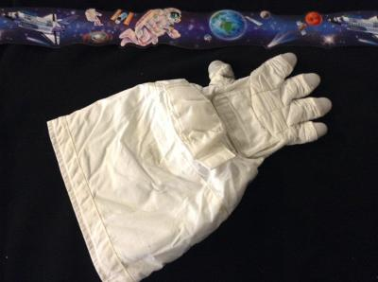
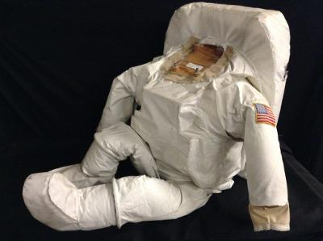
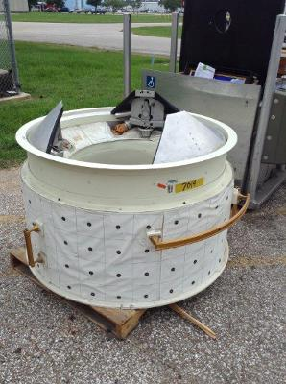
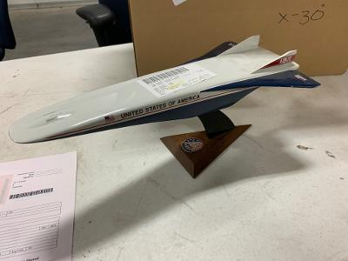
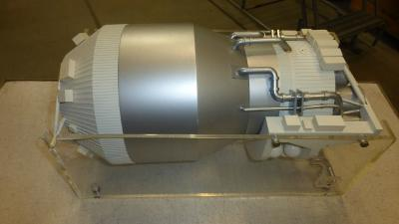
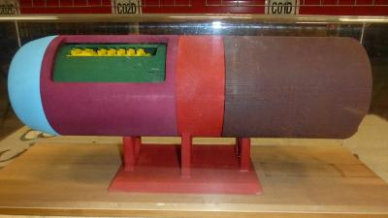
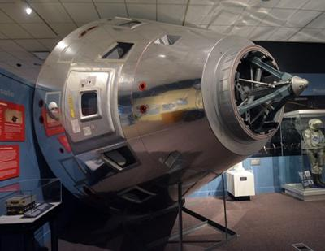
Upcoming Artifacts
Glove TMG, 4500 Series
LOFI EMU Suit Replica
Orbiter Docking System
(OD)
X-30 Return Model
Model, CENTAUR
Model, Jet Engine
Model, Apollo Capsule
Notes:
The term "TMG" in the context of astronaut gloves refers to a Thermal Micrometeoroid Garment. This is an outer layer designed to protect astronauts during spacewalks (Extravehicular Activities or EVAs) from the harsh environment of space
The Extravehicular Mobility Unit (EMU) is an independent spacesuit that provides environmental protection, mobility, life support, and communications for astronauts performing extravehicular activity (EVA) in Earth orbit.
The Orbiter Docking System (ODS) was a crucial component of the Space Shuttle Program, enabling the shuttle to dock with other spacecraft, primarily the International Space Station (ISS)
The Rockwell X-30 was an advanced technology demonstrator project for the National Aero-Space Plane (NASP), part of a United States project to create a single-stage-to-orbit (SSTO) spacecraft and passenger space liner.^{[1]} Started in 1986, it was cancelled in the early 1990s before a prototype was completed, although much development work in advanced materials and aerospace design was completed.
The Centaur is a versatile upper-stage rocket developed by NASA, known for its use in launching a wide range of spacecraft, including lunar probes and interplanetary missions. It's characterized by its use of liquid hydrogen and liquid oxygen as propellants, and its ability to restart its engines in space, enabling complex orbital maneuvers. Centaur has been a workhorse for NASA, contributing to numerous missions and serving as a crucial component in space exploration
JET ENGINE MODEL; APPROX 23"X8"X10«
The Apollo 11 Command Module, Columbia, carried astronauts Neil Armstrong, Edwin "Buzz" Aldrin and Michael Collins to the Moon and back on the first lunar landing mission in July 1969.

Slide 8
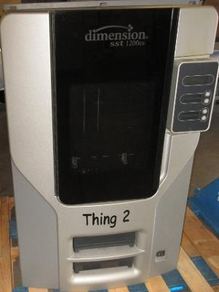
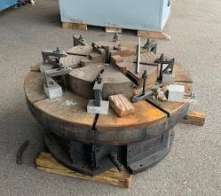
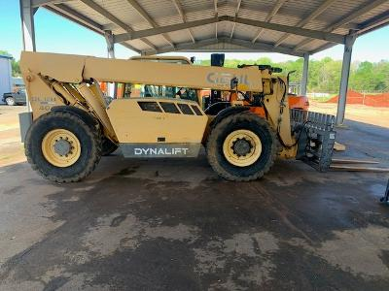
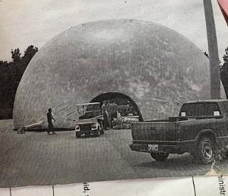
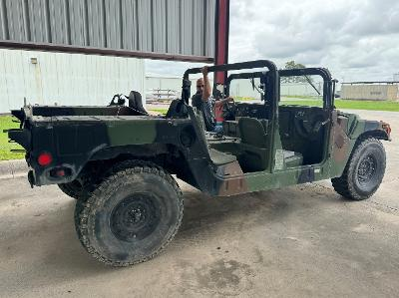


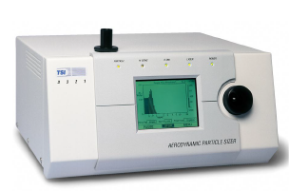
Successes in the Past Year
IL, 3D Printer
UT SASP Table, Rotary
AL, Truck, Lift, Fork
SD, Dome
IL, Lens, HD Eng Full Servo
TX, Truck Utility
AL, Analyzer, Spectrum
FL, Truck Vacuum
Notes:
IL SASP, 3D Printer, $37,615
Utah SASP, Table, Rotary, Indexing, $97,010
Alabama SASP, Truck, Lift, Fork Boom, $83,000
SD SASP, Dome, $69,100
OR SASP, Sizer, Aerodynamic Particle, $44,500
TX SASP, Truck Utility, $41,061
AL SASP, Analyzer, Spectrum, $88,869
FL, Truck Vacuum, $133,926

Slide 9
Successes in the Past Year
Top 10 States receiving property in 2024:
Alabama
Florida
Illinois
Maryland
Minnesota
New York
New Mexico
Pennsylvania
Texas
Utah
Total
2,104 items
valued $27M

Slide 10
Continued Coordination between NASA, GSA & SASP
NASA will continue to work with GSA and the State Agencies on previous donations completed through the GSA Prescreening module
Questions on restriction periods
Questions on export control restrictions
hq-nasa-awg@mail.nasa.gov
The restriction period for artifact allocation through donation is five years
The conditional transfer order may have requirements for the donee to follow relevant Export Control laws indefinitely
NASA can assist in questions regarding final disposition, if necessary
NUO will work with NASA Centers and donees when there are pickup issues
New module will integrate the Agency’s Disposal System to reduce errors, i.e. double allocations
Notes:
Period 59, 2021 (AWG 9 Dec 21), items allocated in Jan 22
We’re still here to work with you regarding items that are in the 5-year restriction period (2026-27).

Slide 11
Upcoming NASA Disposal Projects
Partnerships in Space property
Retirement of ISS program
Budget constraints
Notes:
As of February 2022, NASA announced plans to deorbit the International Space Station (ISS) by January 2031. The process will take several years and involve using a deorbit module to send the ISS into a remote area of the South Pacific Ocean known as the spacecraft cemetery.

Slide 12
Known Disposal Issues
Inaccurate reporting information for excess cases (Acquisition Value, FSC, etc.)
Mass program closures, planned significant surge in reporting of property
Imbalanced expertise and support at NASA locations for Disposal
Training needed for new disposal staff
Property inadvertently processed through PPMS (transition to new system)

Slide 13
NASA HQ POCs
Angel Paschall-Harmon Acquisition & Disposal Program Manager (202) 923-8567, angel.c.paschall-harmon@nasa.gov
Wayne Cragwell Disposal Operations & Artifact Lead (202) 843-4740, Wayne.A.Cragwell@nasa.gov
Artifact Module (https://artifacts.nasa.gov/)

Slide 14
Questions?

Slide 15
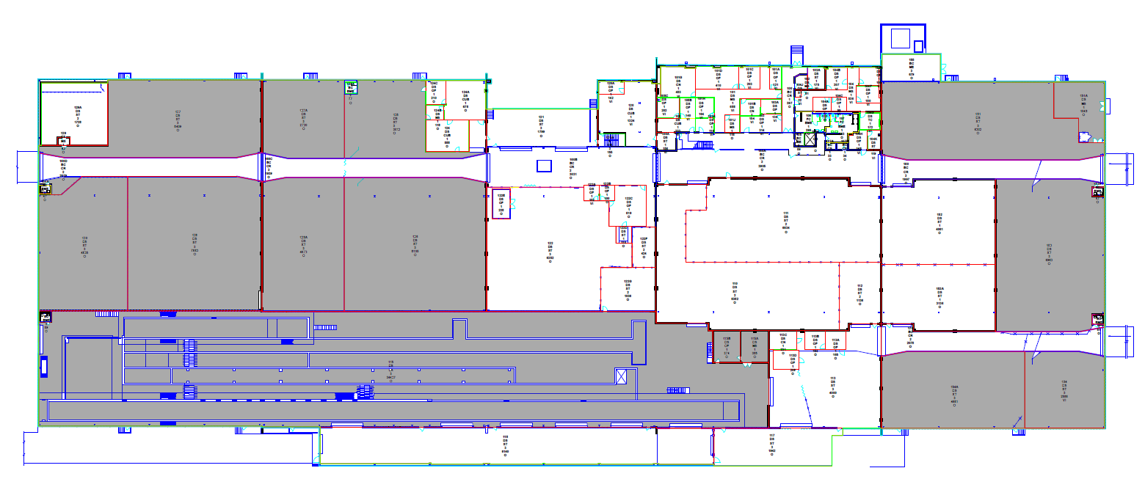
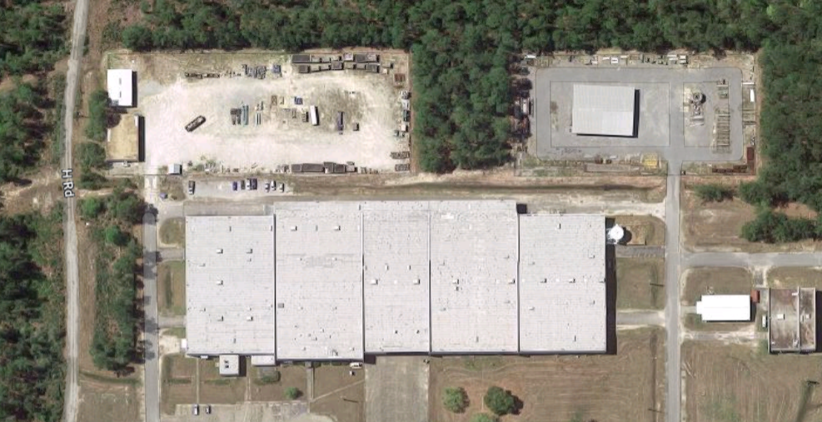
Stennis Space Center Disposal Operation
Logistics Coordination: Establishing Stennis Space Center as a central hub for receiving items from other NASA centers and surrounding federal agencies.
Cost Reduction: Achieving cost savings through bulk processing and centralized management of disposal activities.
Resource Optimization: Better utilization of personnel and equipment by concentrating efforts in one location.
Hub for OFA: Ability for other federal agencies located in the region to dispose of items (e.g., Navy, Government Printing Office, Coast Guard, etc.).
Renovation of Existing Facilities: Upgrading current warehouse spaces to accommodate increased inventory and improve operational efficiency.
Surge capability and Major Program closeout: Providing storage capacity in the event of a surge or the decommissioning of a program/project.
GROUNDS
8100/1100 STORAGE
LOGISTICS PROPERTY
REDISTRIBUTION
PHYSICAL SEC. STORAGE
GROUNDS
REDISTRIBUTION/DISPOSAL
FURNITURE STORAGE
Notes:
Investing in warehouse operation to standup regional surge capability for disposal
Consolidating items from other centers
Much more will be screened from this location

