Slide 1
PPM Update:
NASASP Annual Meeting
July 30, 2025

Slide 2
Agenda
Program Updates & Stats
  Structure & Staffing Updates
  Donation Stats
  Key Initiatives & Legislation
  Program Forms (State Plans, SF 97s, OAC Changes)
  Firearms Program Updates
Fixed Price Sales
Notes:
Agenda from Tim
Wednesday, July 30, 2025 in Mesa Ballroom
8:00 AM – 12:00 PM General Session - Federal Partners
Presiding – Tim Bolles
· Welcome and Introductions
· Federal Partner Presentations
o GSA Personal Property Management General Updates – Matt Manger or Christina Shaw
o PPMS Sales (Fixed Price Sales) Update – Deone
o Applications of Eligibility, Utilization and Compliance, Reviews Updates – Joe Hvorecky or Tara Malone
o Review of SASP retention of surplus property and cooperative agreements – Joe Hvorecky
o Defense Logistics Agency (DLA) – Cassie Gilbert (confirmed)
· Q&A session – SASPs getting clarification from the Federal partners (Joe Hvorecky and Deone)
12:00 PM – 1:00 PM Lunch sponsored by The Public Group
1:00 PM – 4:00 PM General Session - Federal Partners
· Federal Partner Presentations
o GSA Office of Fleet Management – Avital Luny (confirmed)
o Requesting Aircraft and Allocation – Stephon Jackson
o NASA Property
· Q&A session – SASPs getting clarification from the Federal partners (Matt and Christina)
Thursday, July 31, 2025 in Mesa Ballroom
8:00 AM – 12:00 PM General Session - Federal Partners
· GSA Office of Civil Rights - Deborah Cullins Threets CST (confirmed)
· SBA
· GSA Office of Governmentwide Policy – Bill Garrett (confirmed)
· Q&A session – SASPs getting clarification from the Federal partners

Slide 3
PPM Program Updates

Slide 4
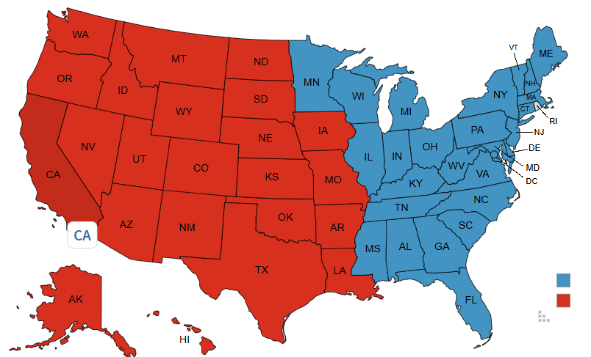
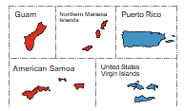
GSA’s Personal Property Footprint
EASTERN ZONE Center of Expertise for Foreign Gifts, Vessels and Animals; Performs Allocation, Eligibility, Compliance and State Agency Reviews for Eastern States. Manages the Personal Property Center in Springfield, VA.
WESTERN ZONE Center of Expertise for Aircraft and Firearms. Performs Allocation, Eligibility, Compliance and State Agency Reviews for Western States.

Slide 5
Key Contacts - Management
Category | Point of Contact (POC) | POC Email
PPM Director | Matthew Manger | matthew.manger@gsa.gov
U&D Director | Christina Shaw (acting) | christina.shaw@gsa.gov
U&D Chiefs | Kevin Murphy (Eastern zone) Randy Gannoe (Western zone) | Kevin.Murphy@gsa.gov randy.gannoe@gmail.com
Sales Director | Deone McMillan | deone.mcmillan@gsa.gov

Slide 6
Key Contacts - SASP Operations
Category | Zone | Point of Contact (POC) | POC Email
Program Data | All | Luis Lopez-Rios Victoria Mancinas | luis.lopezrios@gsa.gov victoria.mancinas@gsa.gov
Allocations & SF 97s | East | Shirley Kimbro | shirley.kimbro@gsa.gov
 | West | Stephon Jackson (allocations) Trey Dyer (97s; CC Stephon Jackson) | stephon.jackson@gsa.gov trey.dyer@gsa.gov (CC: stephon.jackson@gsa.gov)
PPMS Issues & OAC Changes | All | PPMS Inbox | ppms@gsa.gov
Eligibility & Compliance | East | Joe Hvorecky | joe.hvorecky@gsa.gov
 | West | Tara Malone | Tara.Malone@gsa.gov
State Plans | All | Christopher Willett | christopher.willett@gsa.gov
East = Regions 1-5 & 11; West = Regions 6-10; GSA regions map

Slide 7
Key Contacts - POC Lists
Area Property Officers (APOs)
Sales Contracting Officers (SCOs)
Office of Personal Property Management (PPMO)
Centers of Expertise (COEs)

Slide 8
Donation Program Stats
FY | Available | Donated | % Donated
2021 | $2,145,854,640 | $480,519,985 | 22.4%
2022 | $2,185,768,397 | $499,804,460 | 22.8 %
2023 | – | $656,047,955 | –
2024 | $2,952,072,414 | $525,826,865 | 17.8%
2025 (YTD) | $2,168,171,193 | $327,323,924 | 15.5%

Slide 9
Key Initiatives and Legislation

Slide 10
Key Initiatives (FY25)
Challenges:
  Staff and funding reductions
  Travel restrictions
PPMS Systems Enhancements:
  Recent Update: Limiting LT to “1”
  Further DME on hold
PPMS Transactional Survey
  Launched & collecting feedback
  Will inform enhancements when they resume

Slide 11
Key Initiatives (FY25)
Updating:
  Publications (cmls.gsa.gov; search “Personal Property”)
  Presentations (updated Donation of Surplus Property presentation coming soon)
  National Target Distribution Report (NDTR) for FY26
  Single Audit Act threshold for FY26
  SBA FAQs

Slide 12
GSA Issued Memos for FY25
Updated cooperative agreements:
  State-Managed Property Center
  Retention of Surplus Property for State Agency Use
Subrecipient Audit Guidance for Single Audit Act
DEMIL Q6 guidance (coming soon)

Slide 13
RISE After Disaster Act
RISE After Disaster Act (section 2105 of Public Law 114-88)
Contains provisions authorizing the transfer of surplus property to small businesses under certain conditions in disaster areas.
Currently with SBA for implementation. Unclear how small business are determined eligible and who would make the determination.
Notes:
https://www.reginfo.gov/public/do/eAgendaViewRule?pubId=202004&RIN=3245-AH18
SBA suggested that small businesses self-certify, and this is not acceptable or doable.
SBA needs to come up with a way that eligibility can be determined. This must happen before we can proceed.

Slide 14
Computers for Veterans and Students
COVs Act – Requires GSA to transfer repairable surplus to nonprofit refurbishers for eventual distribution to schools, veterans, seniors, and other specified populations in need; and state and local agencies for donation to nonprofit and public entities.
SASPs will still have higher priority on property.
Full implementation TBD (currently on hold)

Slide 15
Program Forms

Slide 16
State Plans
New POC:
  Christopher Willett
  christopher.willett@gsa.gov
Expect some delays

Slide 17
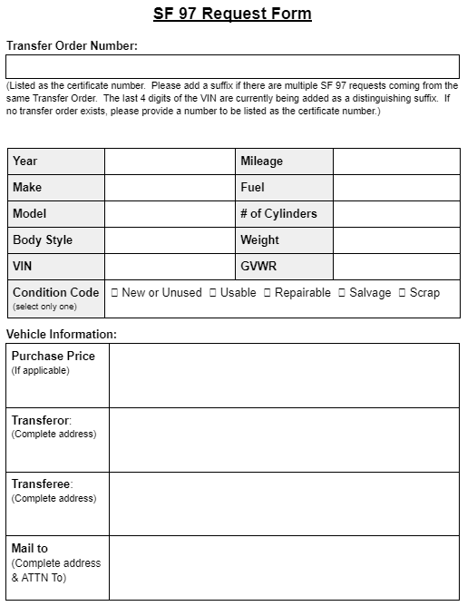
SF 97 Request Form
SF 97s - Frequently Asked Questions
POCs:
Point of Contact (POC) | Allocating Region(s)
Shirley Kimbro shirley.kimbro@gsa.gov | Eastern US (Regions 1-5 & 11)
Trey Dyer (CC Stephon Jackson) trey.dyer@gsa.gov stephon.jackson@gsa.gov | Western US (Regions 6-10)

Slide 18
OAC Change Requests
New process POSTPONED
  PRA processed paused
Notable changes to process:
  Reporting agency concurrence needed
  Official request form (finalized form will be uploaded to PPMS as backup documentation)
Will share for SASP input before implementation
Notes:
We had a lot of data issues in our legacy system.
Want to improve the accuracy of our data in the new system.
Changes at the item level, so impacts all transfers made.

Slide 19
OAC Change Request Format
Requester Name _________________________
Requester Email _________________________
TCN _________________________
ICN _________________________
Original / Listed OAC _________________________
Requested OAC _________________________
Justification _________________________
Supporting Documentation [Attach supporting documentation]
Reporting Agency Concurrence [Insert name, date and email address of person giving agency concurrence]
GSA Concurrence [Insert name, date, email address and associated JIRA ticket number]
Notes:
We had a lot of data issues in our legacy system.
Want to improve the accuracy of our data in the new system.
Changes at the item level, so impacts all transfers made.

Slide 20
Firearms Program Update

Slide 21


Slide 22
Surplus Firearms Discontinued
GSA has discontinued transfers of firearms for surplus donation indefinitely.
  Official announcement from GSA PPM Office on July 24, 2024.
  Email surplusfirearms@gsa.gov to request copy.
Actions Required:
  Full titles transferred, or
  Destruction

Slide 23
Firearms Program Closure
Starting Inventory
  4506 Firearms
  436 Law Enforcement Agencies (LEAs)
  28 State Agencies for Surplus Property (SASPs)
Closure Process Completed (6/2/2025)
  Discontinued title transfers
  Continued Monitoring
  Program Reviews

Slide 24
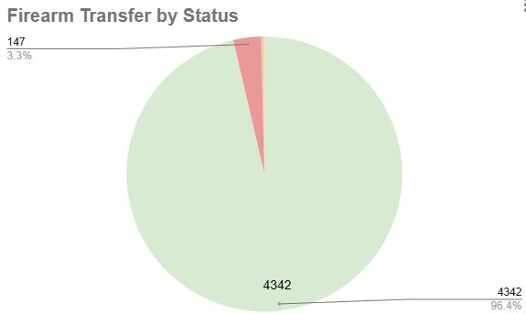
Firearms Inventory
4506 Firearms on Inventory
  4342 Firearm Titles Transferred to LEAs
  147 Firearms Destroyed (in lieu of title)
  15 Firearms Held as Evidence*
  1 Firearm Missing and Under Investigation**

Slide 25
Continued Monitoring
Annual Firearm Inventory is no longer required.
Recovered firearms previously reported as missing/lost must be destroyed; contact GSA Firearms Manager immediately for instructions.

Slide 26
Pending Final Disposition
Firearms currently pending final disposition;
  Held as Evidence*, Require status updates every 6 months.
    Must be destroyed upon release.
    Not eligible for title transfer.
  Missing and Under Investigation**, Pending results.
    Administrative fee may be required.
    If recovered; must be destroyed.

Slide 27
State Review Requirements
States who have participated in the program must retain closure documents perpetually.
  Annual physical firearm inventory is discontinued.
GSA State Review Team will evaluate firearm closure packets in lieu of physical inspections or LEA visits.
  LEAs who participate in surplus program other than receiving firearms, may be visited by state review team.

Slide 28
PPMS Updates
The closure of the surplus firearms program does not impact how Federal agencies report firearms.
  Excess firearms visible in PPMS but will never become surplus.
Add to cart PPMS features for SASPs will be deactivated for firearms and ammunition.
  FSCs - 1005, 1010, 1095, 1305, 1395
PPMS User Accounts for LEAs, locked with VO Permission.
  SASPs may unlock and update for LEAs as applicable

Slide 29
Important Reminders
The LESO (Law Enforcement Support Office) program is still available.
For questions or concerns;
  GSA Firearms Manager, surplus firearms@gsa.gov

Slide 30
Questions?

Slide 31
Thank you!
Christina M. Shaw
Deputy Director
Office of Personal Property Management
215-446-5083 (desk)
856-371-1606 (cell)
215-873-8492 (fax)
christina.shaw@gsa.gov

Slide 32
Fixed Price Sales

Slide 33
Fixed Price Rules and Regulations
Federal property that requires reimbursement is not eligible for the Donation program (FMR 102-37.40(g))
Fixed price sales cannot be made to a non-profit or business
  regulations state that the sales are made to a State, territory, or possession of the United States, or to a political subdivision of, or a tax-supported agency in, a State, territory, or possession
SASP may be an inactive participant in sales to eligible participants (e.g., bring parties together)
Speculative fixed price sales are inappropriate. SASP should have a targeted eligible purchaser

Slide 34
Donation Program Funds
Federal donation program funds can NOT be used to pay for the fixed price vehicles
Cost and “seed” money to purchase vehicles can NOT come from the Donation program
Fixed price sale is a sale – not a Donation
Exception: if a SASP acquires a vehicle to run the Donation program

Slide 35
Fixed Price Sales: Availability
Availability
  Exchange sale property reported into PPMS
Screening
  3 business days (expedited screening)
Eligibility
  Public bodies only
  Nonprofits and other organizations are not eligible)

Slide 36
Fixed Price Sales: Acquisition
Note: do NOT checkout the item in PPMS
SASP contacts zonal Sales Contracting Officer (SCO) to request a fixed price sale
SASP confirms eligibility of the requesting donee
SCO coordinates with the owning agency for concurrence of Fair Market Value (FMV) sale
SCO awards the contract
SASP pays within 30 days (FMR 102-38.350)
SCO forwards Purchaser’s Receipt to SASP and owning agency
Notes:
Acquisition
Do NOT checkout the item
SASP notifies the designated Zonal SCO to request a fixed price sale for the vehicle(s)
SASP includes a confirmation of eligibility for the donee requesting to purchase
The Sales Contracting Officer coordinates with the owning agency for concurrence of Fair Market Value (FMV) sale
Completion of contract award documents
Purchase receipt forwarded to the SASP and owning agency
Payment and Collection
Must be made within 30 days; (FMR 102-38.350)

Slide 37
Fixed Price Sales: Removal
Purchaser’s receipt not required for pick up (since SASP has 30 days to pay)
SASP or donee coordinates with owning agency to schedule appointment for removal
Must remove within 10 days of award

Slide 38
SASP Fees for Fixed Price Sales
Reminders:
  If you are charging a fee for fixed price, it needs to be in your State Plan.
  Adding the language is considered a minor amendment
  PPM Central Office can provide sample language if needed

Slide 39
Questions?

Slide 40
Thank you!
Deone McMillan
Sales Director
Office of Personal Property Management
Office (404) 331-0543
Cell (404) 309-0482
deone.mcmillan@gsa.gov

