Slide 1
Applications of Eligibility, Utilization and Compliance, Reviews: Hot Topics
Federal Surplus Personal Property Donation Program
NASASP-July 2025
Tara Malone
Western - COE Eligibility & Compliance
Western Zone

Slide 2
Topic to Cover
Eligibility: Homeless/Impoverished Provider Donees - Review
VOSB Q&A’s – Discussion
New Audit Guidance
Compliance Reminders

Slide 3
Homeless/Impoverished Provider Donees
Stewart B. McKinney Homeless Assistance Act
(P.L. 100-77 enacted July 22, 1987; renamed McKinney- Vento, 42 U.S.C. § 11301 et seq.)
P.L. 105-50 (1997)
41 C.F.R. § 102-37: Definitions

Slide 4
Homeless/Impoverished Provider Donees
Homeless Individual: An individual who lacks a fixed, regular, and adequate nighttime residence, or who has a primary nighttime residence that is:
  A supervised publicly or privately operated shelter designed to provide temporary living accommodations (including welfare hotels, congregate shelters, and transitional housing for the mentally ill);
  An institution that provides a temporary residence for individuals intended to be institutionalized; Or
  A public or private place not designed for, or ordinarily used as a regular sleeping accommodation for human beings
  The term homeless individual does not include any individual imprisoned or otherwise detained pursuant to an Act of the Congress or a State law (for the purposes of this part)

Slide 5
Homeless/Impoverished Provider Donees
Provider of Assistance to Homeless Individuals: A public agency or a nonprofit institution/organization that operates a program which provides assistance such as food, shelter, or other services to homeless individuals
Provider of Assistance to Impoverished Families and Individuals: A public or nonprofit organization whose primary function is to provide money, goods, or services to families or individuals whose annual incomes are below the poverty line (as defined in section 673 of the Community Service Block Grant Act 42 U.S.C. 9902).

Slide 6
Homeless/Impoverished Provider Donees
Includes (not limited to) organizations providing:
  *Medical care
  *Scholarship and tuition assistance
  *Tutoring and literacy instruction
  *Job training and placement
  *Employment Counseling
  *Clothing distribution
  *Self-help housing
  *Medical transportation
*Home construction or repairs
*Utility or rental assistance
*Legal counsel
*Childcare assistance
*Meals or other nutritional support
*Food Banks

Slide 7
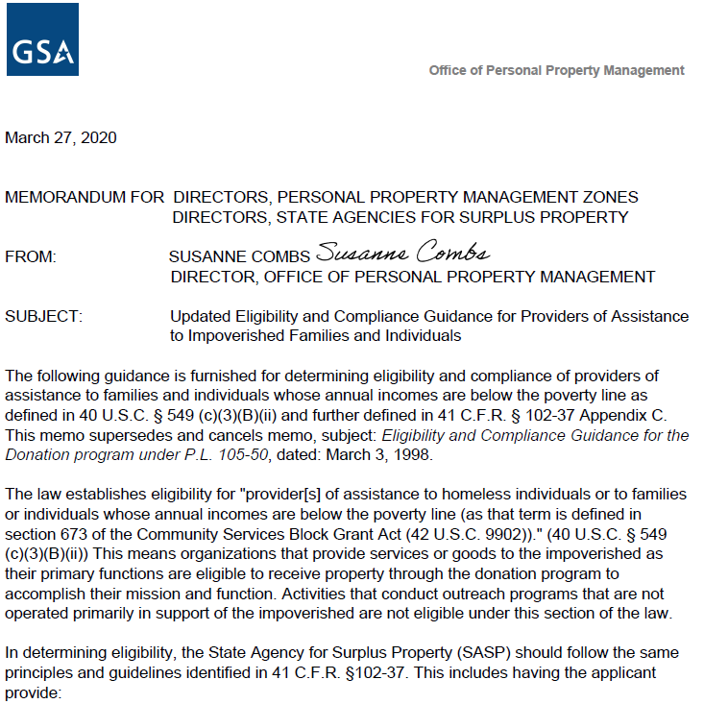
Homeless/Impoverished Provider Donees
GSA Policy Memorandum – Updated Eligibility and Compliance Guidance for Providers of Assistance to Impoverished Families and Individuals (March 27, 2020)
Below Poverty Line
  defined in 40 U.S.C. § 549(c)(3)(B)(ii)
  clarified in 41 C.F.R. § 102-37 Appendix C
  based on the Community Services Block Grant Act (42 U.S.C. § 9902)
Assisting the impoverished/homeless must be primary function

Slide 8
Homeless/Impoverished Provider Donees
Copy of IRS letter or proof of tax-exempt status under section 501 of the Internal Revenue
Detailed description of services and programs, including how financial eligibility is determined
Details on physical facilities, including staffing hours
Copies of charter, bylaws, articles of incorporation, and program literature
Licenses or accreditation proofs if required by state or local laws (e.g., for daycare centers)

Slide 9
Homeless/Impoverished Provider Donees
A letter of certification from a public official (e.g., mayor, county supervisor, or agency head overseeing impoverished programs) confirming public recognition as a provider, specifying services are primarily for the impoverished, and matching the name in tax-exempt documentation (41 C.F.R. § 102-37.390).
  The certification should:
  • Identify the organization by name.
  • Specify the services provided (e.g., food distribution, shelter, medical care, job training).
  • Confirm that these services primarily serve the impoverished or homeless.
  • Define the geographic area served (e.g., city, county, or region).
Notes:
*The memo requires this type of donee to submit a letter from a public official confirming recognition as a provider, specifying services are primarily for the impoverished or homeless. This letter could come from a mayor, county supervisor, housing authority, or an equivalent. But it must be someone who has direct knowledge and responsibility for programs addressing poverty or homelessness in the applicant’s service area. They must explicitly certify the applicant's clientele are individuals or families whose annual incomes are below the poverty line or who are homeless. This public official’s letter will give them the validation they need for eligibility into the Donation Program.
.

Slide 10
Homeless/Impoverished Provider Donees
I, [P.O.’s Name, Title], hereby certify that [Organization] primarily serves impoverished individuals and families whose annual incomes are below the poverty line, as defined in 42 U.S.C. § 9902, and/or homeless individuals, as defined in 42 U.S.C. § 11302, in [specific geographic area, e.g., City X or County Y].
[Organization] provides [specific services, e.g., food distribution through a food bank, emergency shelter, medical care, or job training] to this population as its primary mission. These services directly address the needs of the impoverished and homeless in our community, ensuring access to essential resources and support.
Should you require additional information, please contact me at [contact information].
Sincerely,
[Signature + P.O.’s Name and Title]
Notes:
•The letter must be with an official letterhead. SASPs must verify the letter’s authenticity, ensuring the official has relevant authority and knowledge of the applicant’s services and verify it aligns with the certified purpose (Handbook Ch. 5, Para. 5(b); FMR § 102-37.390). Make sure you check the public official’s authority—such as confirming with municipal websites or agency records. You must ensure the letter specifies the organization, services, and impoverished/homeless focus. Reject any vague or non compliant letter and avoid trying to make a letter work if it does not meet this standard. This is a donee’s responsibility for eligibility and not the SASP’s.

Slide 11
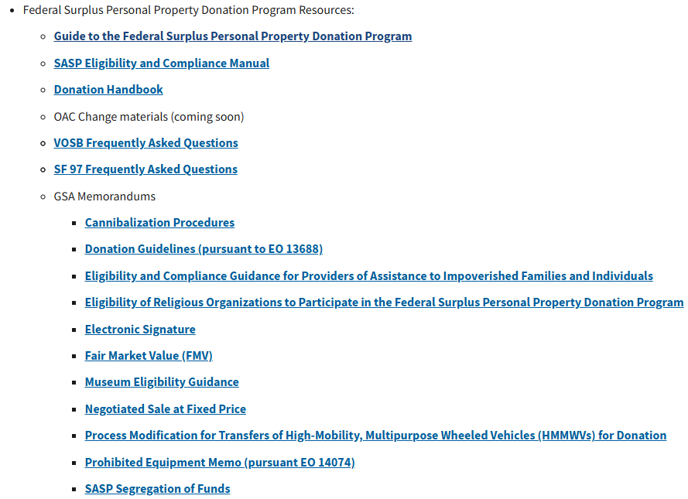
Veteran Owned Small Business Q&As

Slide 12
Veteran Owned Small Business Q&As
Paperwork & Records
MOA Participation: Optional for SASPs; no legal violation if opting out, but signing encouraged (Q1, Q2).
File Retention: Follow State Plan and FMR 102-37 Appendix B(p) (Q4).
Electronic Signatures: Permitted per GSA’s memo on acceptable forms (Q5).
Reporting: VOSB donations reported quarterly via PPMS 3040 report with new “SBA VOSB” field; additional reports may be required (Q6).
Single Audit Act: Does not apply to VOSBs as for-profit entities (Q7).

Slide 13
Veteran Owned Small Business Q&As
VOSB Certification & Eligibility
SBA Dynamic Small Business Search: Firms listed are verified, not self-certified; safe to assume eligibility (Q9).
Verification Issues: If not listed, accept SBA approval letter + email verification (Q10).
Recertification: VOSBs recertify every 3 years; SASPs track expiration dates (Q11).
Multi-State Operations: VOSBs need a physical location and state business license per state; property stays in donating state unless approved (Q12, Q13).

Slide 14
Veteran Owned Small Business Q&As
VOSB Certification & Eligibility
Ineligible Businesses: Excludes illegal activities, gambling, lending, etc. (Q14).
Size Standards: Per SBA’s Table of Size Standards (effective March 17, 2023), based on NAICS codes, employees, or receipts (Q15).
No Conditional Eligibility: Full SBA verification required (Q16).
Dual Eligibility: SBA 8(a) and VOSB firms can access both programs if SASP signed both MOAs (Q17).
Contractor Role: Can assist with applications but must be signed by VOSB owner; authorized reps tied to mission (Q18, Q19).

Slide 15
Veteran Owned Small Business Q&As
Acquiring & Using Personal Property
Non-Signing States: VOSBs can’t access property unless MOA signed; cooperative MOUs between adjacent states possible (Q20).
Reimbursable Items: VOSBs cannot purchase these, as they’re not public bodies (Q21).
Multi-State Property: Property acquired from SASP where it will be primarily located; approval needed for long-term moves (Q22, Q23, Q24).
No Renting: VOSBs cannot acquire property to rent out; must use it for their own business purposes (Q25).
Acceptable Use: Property must align with VOSB’s normal business activities; SASPs document alignment; marketing (e.g., static helicopter display) generally not allowed (Q27).

Slide 16
Veteran Owned Small Business Q&As
Compliance
Reporting Issues: Send compliance issues to GSA (regional POCs: Joe Hvorecky for eastern states, Tara Malone for western) and SBA (Amy Kim, Nick Manalisay) (Q28).
Temporary Deferral: VOSBs can regain eligibility with compliance resolution and approved corrective action (Q29).
Multi-State Deferral: If deferred in one state, VOSBs can’t receive donations in others (Q30).
Contractor Use/Storage: Contractors can use property only for VOSB’s mission; storage at contractor sites generally not allowed due to risk (Q31, Q32).

Slide 17
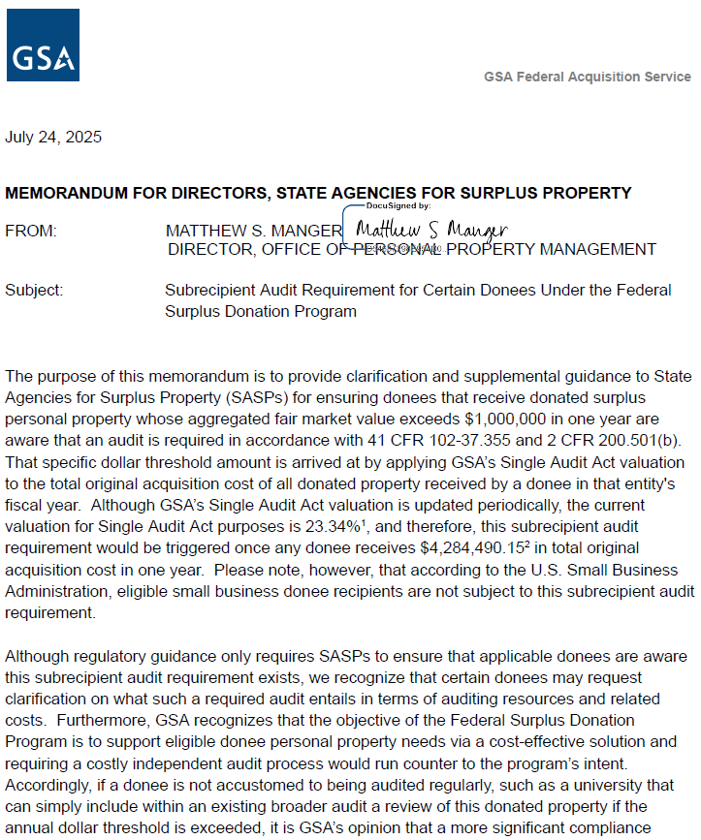
Subrecipient Audit Requirement for Certain Donees: GSA Guidance

Slide 18
Subrecipient Audit Requirement for Certain Donees: GSA Guidance
Regulatory Framework and Audit Requirement
Authority: 41 C.F.R. § 102-37.355 and 2 C.F.R. § 200.501(b) (Single Audit Act)
Requirement: Donees receiving surplus property with a fair market value (FMV) >$1,000,000 in their fiscal year must undergo a subrecipient audit.
Purpose: Ensures accountability and proper use of donated federal property.
SASP Responsibility: Inform applicable donees of the audit requirement (41 C.F.R. § 102-37.355).
*Exemption: Small business donees (e.g., VOSBs, SBA 8as) are not subject to this requirement, per SBA guidance.

Slide 19
Subrecipient Audit Requirement for Certain Donees: GSA Guidance
Calculating the Audit Threshold
Threshold: FMV of donated property >$1,000,000 in donee’s fiscal year triggers audit.
Valuation Method: FMV = 23.34% of total original acquisition cost (OAC) of all donated property (GSA Single Audit Act valuation, 2025).
Calculation: OAC ≥ $4,284,490.15 triggers the $1,000,000 FMV threshold ($4,284,490.15 × 0.2334 = $1,000,000).
Example: A nonprofit receiving $5,000,000 OAC in equipment (e.g., vehicles, computers) has an FMV of $1,167,000, requiring an audit.
• Note: Valuation percentage may update periodically; check GSA guidance.

Slide 20
Subrecipient Audit Requirement for Certain Donees: GSA Guidance
Challenges, GSA’s Approach, and Intent of Guidance
Challenge: Independent audits can be costly, countering the program’s cost-effective intent.
GSA Stance: Recognizes burden on donees not regularly audited (e.g., unlike universities that can fold this into broader audits).
Solution: SASPs can conduct alternative compliance reviews to satisfy audit requirements (GSA Memo, July 24, 2025).

Slide 21
Subrecipient Audit Requirement for Certain Donees: GSA Guidance
Intent and Clarification
For nonprofits with limited budgets not receiving broader federal assistance but subject to Single Audit Act as subrecipients.
Ensure consistent application: Do not replace existing broader audits with this guidance.
GSA does not advocate substituting traditional financial audits with cost-effective options if donee already has audits.
Goal: Balance accountability with program accessibility, especially for smaller donees.

Slide 22
Subrecipient Audit Requirement for Certain Donees: GSA Guidance
SASP Audit Check Options and Applicability
Options for Subrecipient Audit Compliance:
1. In-Person Verification: SASP conducts on-site inspection of donated property.
2. Digital Photos: Donee submits time-stamped photos of property in use, reviewed by SASP.
3. Virtual Visit: SASP verifies via video call (e.g., Teams, Zoom).
• Not Acceptable: Self-certification utilization surveys alone do not suffice.

Slide 23
Subrecipient Audit Requirement for Certain Donees: GSA Guidance
SASP Audit Check Options and Applicability
Applicability: SASPs can conduct checks on all items for donees like museums/nonprofits where full audits are burdensome (per FMR 102-37.355 and 2 C.F.R. § 200.501(b)).
Outcome: If all items comply with terms/conditions, traditional audit may not be required—depends on other federal assistance and audit obligations.
Flexibility: Options account for varying SASP resources and donee capabilities.
Documentation: Record compliance audit checks in file; retain per state plan (current year + 3 years, Appendix B(p)).
Notes:
This guidance applies to donees such as museums or other nonprofits where a full audit would be financially burdensome, allowing SASPs to verify all items virtually or in-person under FMR 102-37.355 and 2 C.F.R. § 200.501(b). If all items are found compliant with the program’s terms and conditions, a traditional financial audit might not be necessary—but this depends on what other federal financial assistance the organization receives and their overall audit requirements. Choose the option based on your resources, and document all of these audit reviews in the file.

Slide 24
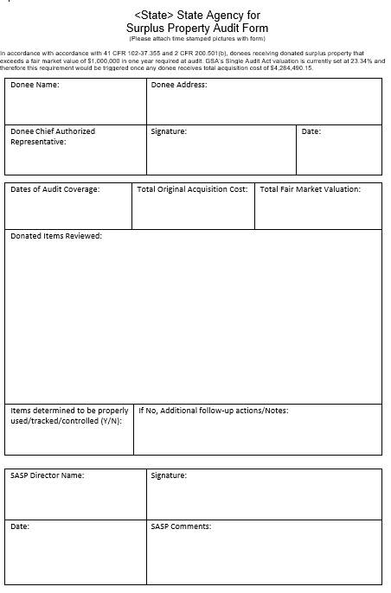
Subrecipient Audit Requirement for Certain Donees: GSA Guidance
SASP Audit Check Options and Applicability

Slide 25
Subrecipient Audit Requirement for Certain Donees: GSA Guidance
Timing of Audit Checks and SASP Responsibilities
Audit Frequency: Annual, per 2 C.F.R. § 200.504.
Timing:
  Conducted in the balance of the fiscal year after threshold is reached, or within 30-45 days after FY close.
  Depends on when $1,000,000 FMV ($4,284,490.15 OAC) threshold is met.
Notes:
Audits must be conducted annually, as specified in 2 C.F.R. § 200.504. The compliance audit check should occur in the remaining portion of the fiscal year once the threshold is reached, or within 30-45 days after the fiscal year closes, depending on timing. For instance, if a donee hits the $1,000,000 FMV threshold mid-year, aim to complete the check before year-end or shortly after.

Slide 26
Subrecipient Audit Requirement for Certain Donees: GSA Guidance
Timing of Audit Checks and SASP Responsibilities
Notify donees nearing/exceeding threshold of audit requirement.
Track donations to monitor OAC and calculate FMV (23.34% of OAC).
Conduct and document one of the three approved methods.
Report to GSA: Include audit compliance in file; submit annual audit report (41 C.F.R. § 102-37.360).
Best Practices:
• Train staff on valuation, compliance options, and timing.
• Communicate early with donees about potential audit triggers.
• Coordinate with GSA Zonal Centers for guidance.

Slide 27
Applications of Compliance
Utilization Standards (General)
Ensuring property serves intended purposes
Place in use within 1 year of donation
Continue use for at least 1 year (+6 mos if High Value Item) after placement. Enhanced monitoring:
  High-Value Items: > $5,000 and passenger vehicles
  Special Restrictions:
  • Aircraft/Vessels: 5 years (perpetual for combat-configured aircraft)
  • Cannibalized Property: Restriction until completion; components $5,000+ remain restricted

Slide 28
Applications of Compliance
Utilization File
-Transfer Order
-Signed Distribution Document/Invoice
-In-use Utilization Report
-Continued Use Utilization Report(S)
-Pertaining Documentation
-copy of SF97
-In-use Extension Approvals
-Compliance Violation documents
-Cannibalization Requests/Approvals
-permissions to take out of state

Slide 29
Questions?
Tara Malone
E&C COE Western
SW Central Zone
tara.malone@gsa.gov
(817) 682-8941
Notes:
Reminder to come to the monthly eligibilitiy and compliance class.

