Slide 1

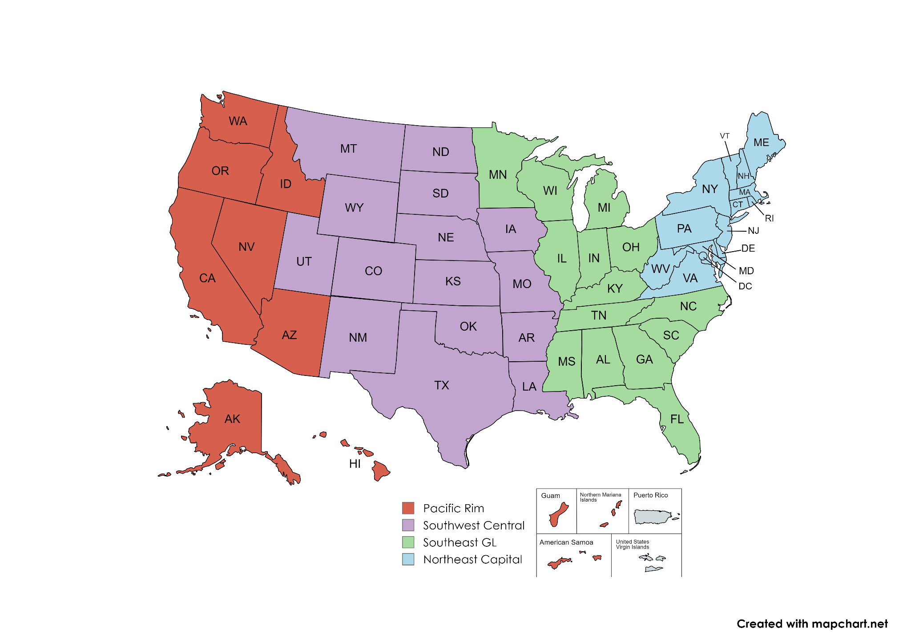
Personal Property Zones & COEs
Northeast Capital:
DOD Vessels (>=50 ft)
Foreign Gifts
Animals
Eligibility & Compliance (Eastern)
Joseph M. Hvorecky - (215) 266-4505
Charles Robinson - (202) 465-5758’
Southeast Great Lakes:
Civilian Vessels (>=50 ft)
Donation Allocations (Eastern States)
Karen Warrior (404) 433-8537
Candice Threatt (312) 520-9215
Southwest Central:
Firearms
Eligibility & Compliance (Western)
Jennifer Koranda (817) 205-5324
Teresa Purifoy (817) 507-6213
Randy Gannoe (817) 850-5587
Pacific Rim:
Aircraft
Donation Allocations (Western States)

Slide 2
Aircraft Donations

Slide 3
Aircraft Request Checklist
-Letter of Support (SASP)
-Letter of Intent (Donee)
-Aircraft Compliance Acknowledgement Letter
-Eligibility and/or current compliance documents maybe requested by COE.

Slide 4
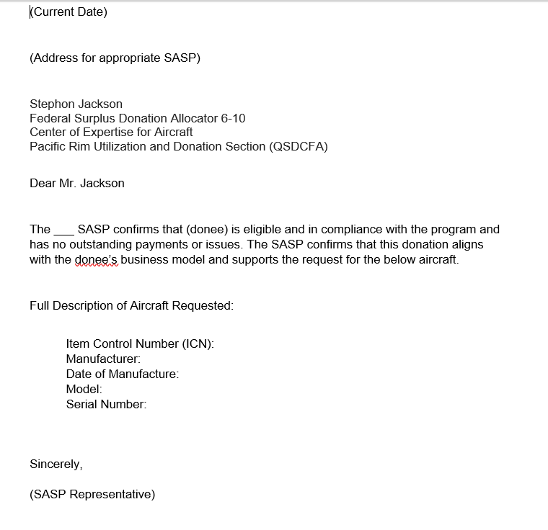
Letter of Support

Slide 5
Letter of Intent

Slide 6
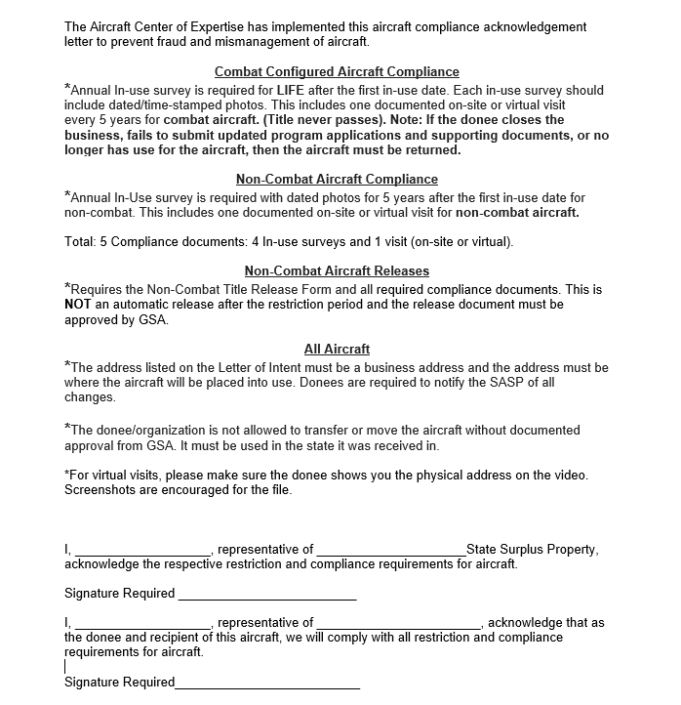
Compliance Acknowledgement Letter

Slide 7
Post Allocation Checklist
- SF 123 (can be electronically signed in PPMS ___Notarized conditional transfer document (CTD).
For NON-FLIGHT use you need to do 2 original copies and for FLIGHT use, 2 original copies. One copy will be sent to GSA via email, one copy for the file and one copy to the donee or two if for flight use because one will need to go to FAA for registration.
___The invoice or distribution document.
Please file the documents at the SASP office and send copy to:
Stephon.jackson@gsa.gov

Slide 8
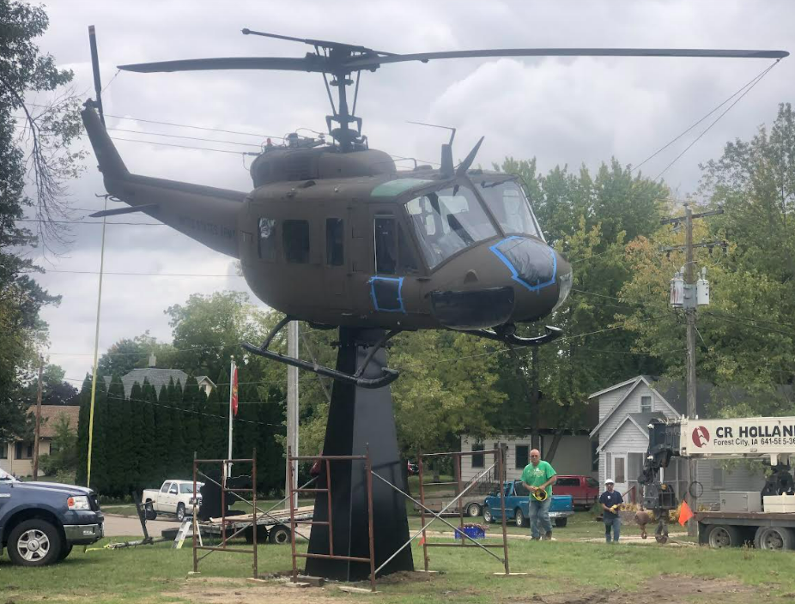
Award to MN for Memorial at City of Emmons.

Slide 9
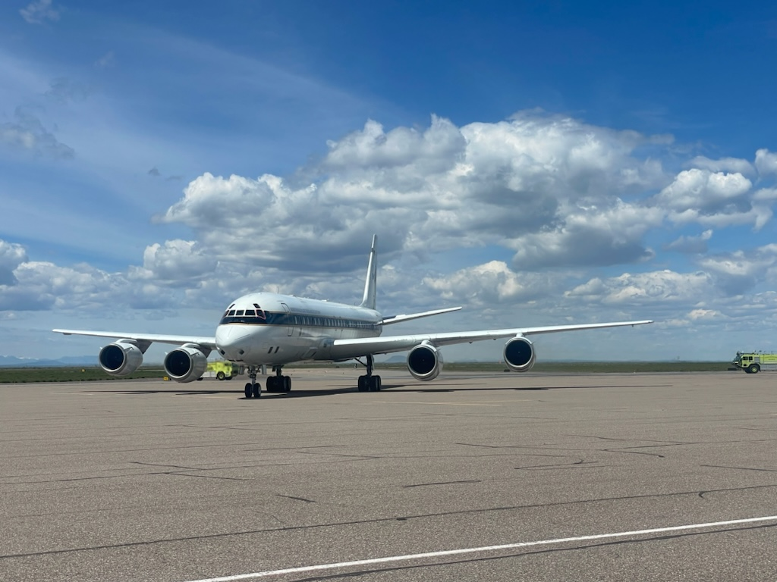
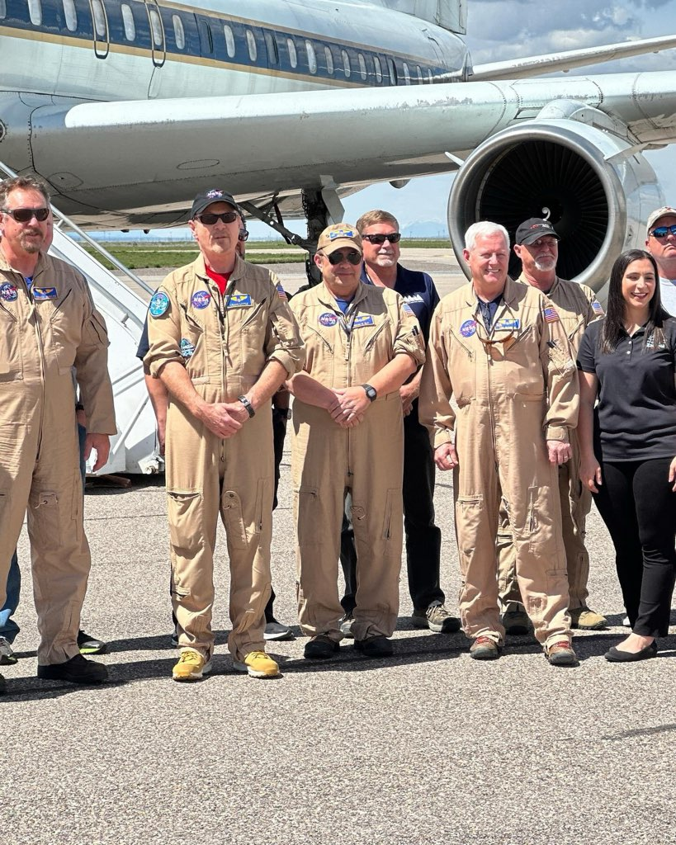
NASA Delivery of DC-8 to Idaho State University

Slide 10
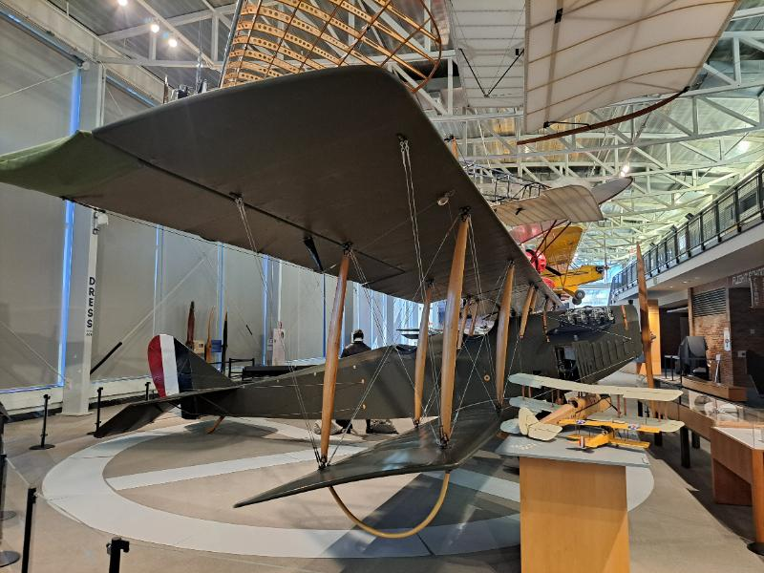
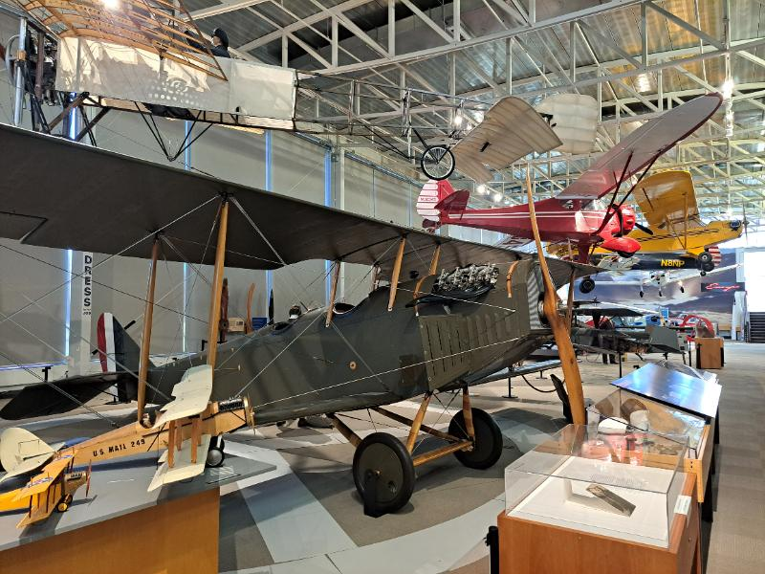
Army Loan Program to College Park Aviation Museum, MD

